Slide 1

Scrum-Agile vs. Waterfall: Which Development Approach is Right for Your Project?
By Euntak Jang

Slide 2

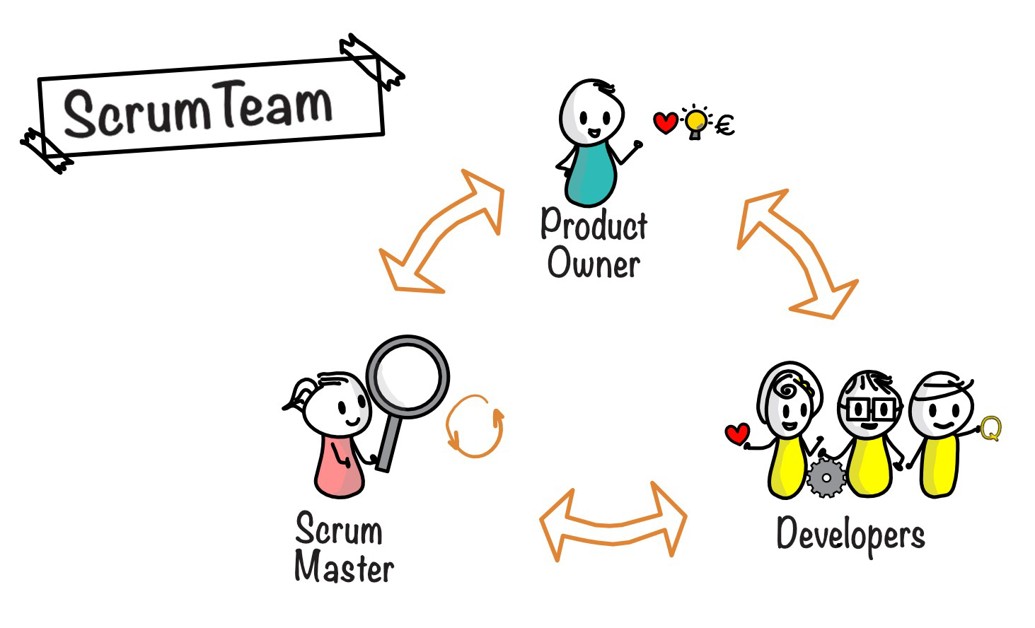
Breakdown of the Scrum-Agile Team

Slide 3
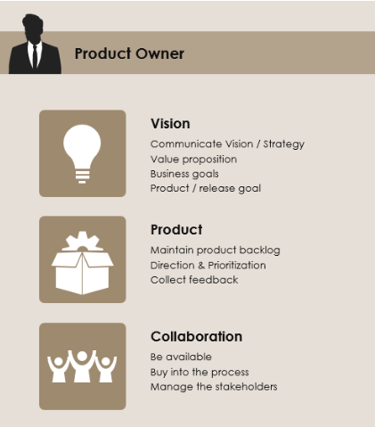
Product Owner
The product owner is in charge of establishing and prioritizing the product backlog.
They collaborate closely with stakeholders to ensure that the product fulfills their needs, and they make judgments on which features to add in each sprint.
The product owner is an important function since they are responsible for ensuring that the product satisfies the demands of the consumer and the business.

Slide 4
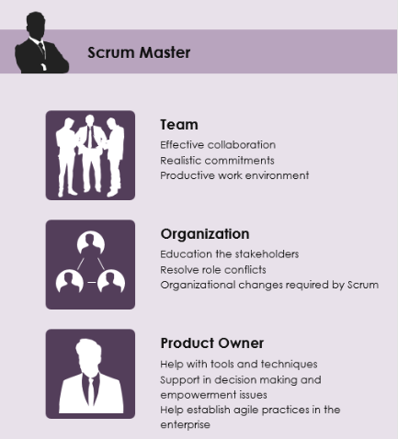
Scrum Master
The Scrum Master is in charge of ensuring that the team follows the Scrum methodology and that any roadblocks to progress are removed.
They help Scrum activities like daily stand-ups, sprint planning, and retrospectives run well.
The Scrum Master is also in charge of ensuring that the team self-organizes and has the tools and resources it requires to succeed.

Slide 5
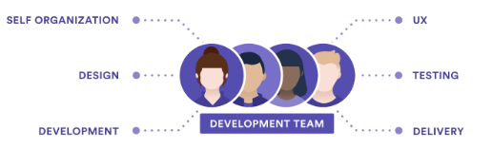
Development Team
The development team is in charge of providing potentially shippable portions of the product.
They collaborate to finish the work stated in the sprint backlog, and they are cross-functional, which means they have all of the abilities required to do the job.
The development team is crucial since they are in charge of producing the product and ensuring that it fulfills the team's quality standards.

Slide 6
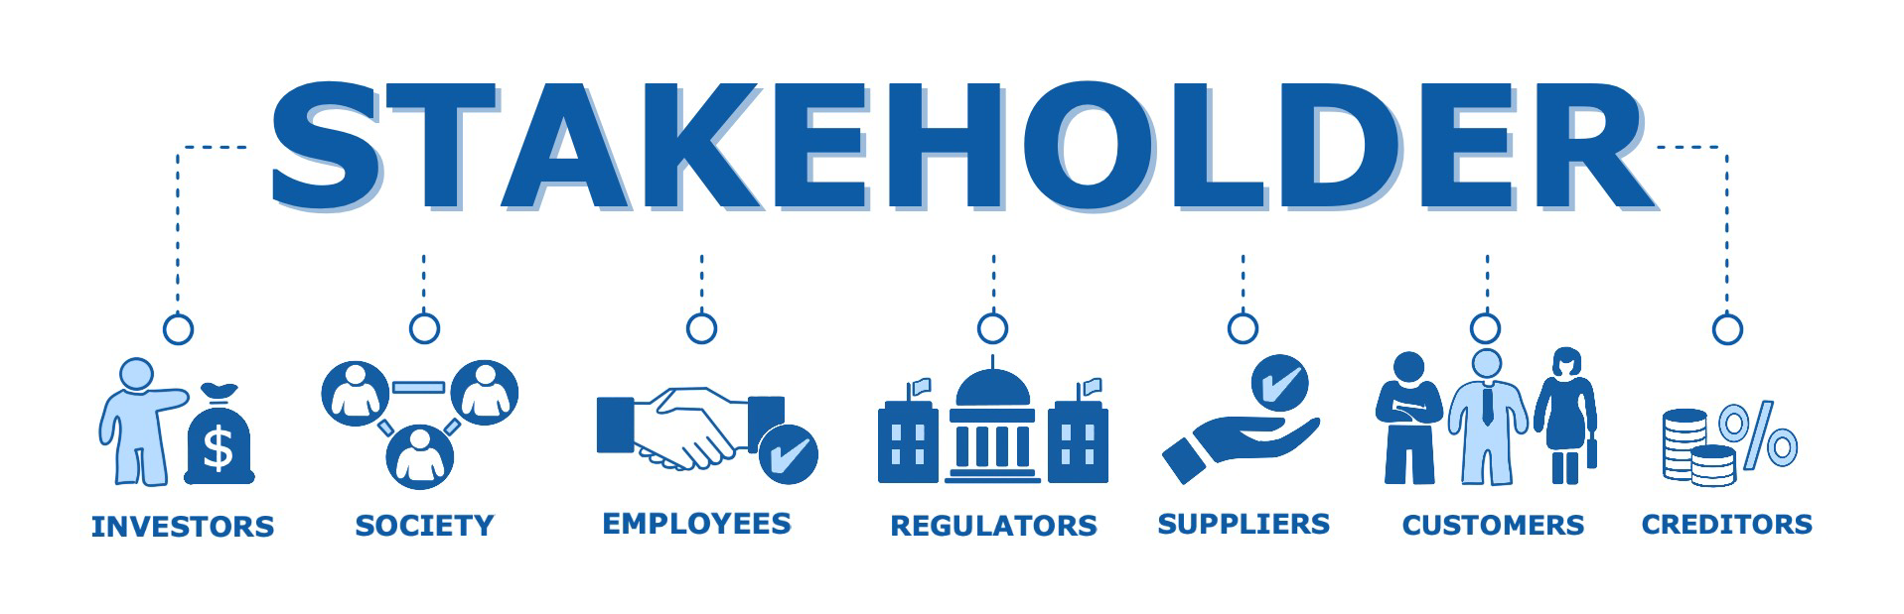
Stakeholders
Customers, users, and company executives are all considered stakeholders.
Stakeholders offer input on the product, which helps the product owner and development team decide which features to add in each sprint.
Stakeholder input is crucial since it guarantees that the product satisfies the needs of both the consumer and the company.

Slide 7

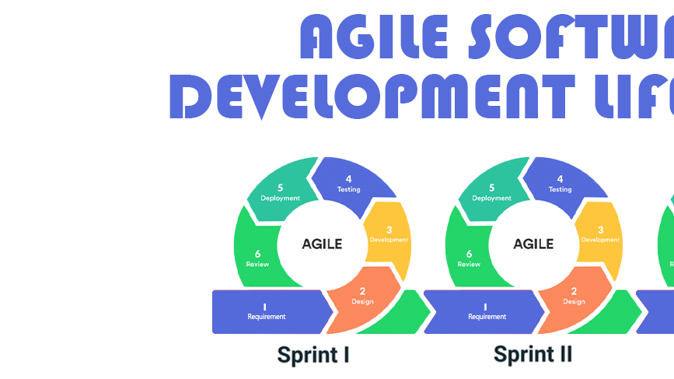

Phases of SDLC in Agile Approach
z

Slide 8

Planning
During the planning phase, the team develops a product backlog and establishes sprint objectives.
The product backlog is a prioritized list of product features that need to be built. Sprint goals are the sprint's high-level objectives.
The planning phase is critical because it establishes the sprint's direction and ensures that the team is focusing on the most essential features.

Slide 9
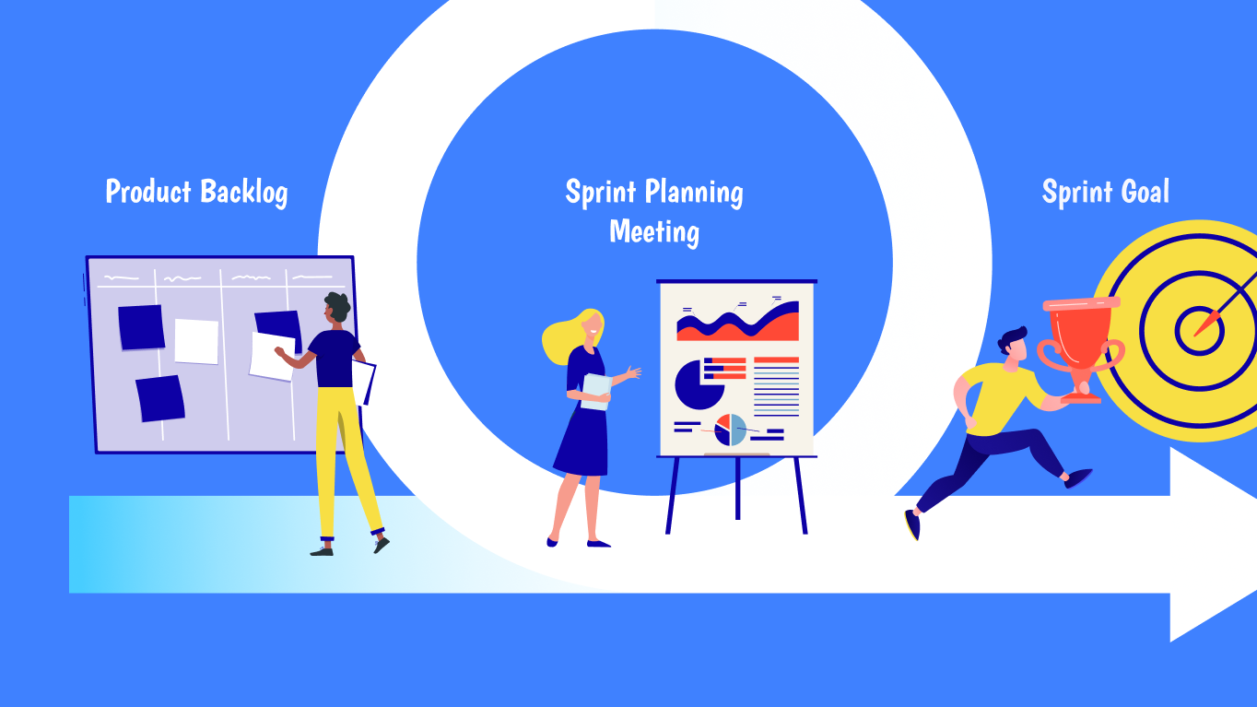
Sprint
A sprint is a timed period (often 1-4 weeks) during which the team works to produce a set of product enhancements.
The development team collaborates to finish the work outlined in the sprint backlog, which is a collection of product backlog features that the team intends to deliver in the sprint.
The sprint is significant because it offers a time-bound framework for the team to work within and guarantees that features are delivered on a consistent cadence.

Slide 10

Review
The review phase is where the team delivers the completed work to stakeholders for comments.
The team shows off the features they developed during the sprint, and stakeholders offer comments on the work.
The review phase is critical because it ensures that the team is delivering features that match the demands of the customer and the company.

Slide 11

Retrospective
The team reflects on the sprint and identifies areas for improvement during the retrospective phase.
The team talks about what went well, what might have been done better, and what adjustments they can do in the next sprint to improve.
The retrospective phase is critical because it guarantees that the team is always developing and learning from their work.

Slide 12

Waterfall vs Agile Approach
z

Slide 13

Waterfall
Each step of waterfall development is completed before moving on to the next. Agile development, on the other hand, works iteratively and incrementally, with each sprint building on the preceding one.
This implies that if an issue is detected during development, the technique for resolving it will be different in each approach.

Slide 14
Waterfall cont.
Whenever an issue is detected during testing in a waterfall approach, the development team must return to the design phase to make modifications.
This can be time-consuming and costly, as adjustments are more difficult to make once a phase is done.
In contrast, under an agile methodology, modifications may be made more readily throughout the sprint since the team can modify their work depending on feedback and new information.

Slide 15

Example
For example, if the development team realized that a feature they were developing did not satisfy the expectations of the client, they might alter their work throughout the sprint to guarantee it did.
They might also prioritize modifications to the product backlog based on feedback, ensuring that the most critical items are delivered first.
Under a waterfall model, the team would have to wait until the testing phase to find the problem, at which time they would have to return to the design phase and make adjustments. This might cause the project to be delayed and result in higher expenditures.

Slide 16

Addressing The Problem
The procedure for addressing difficulties in development is only one example of how waterfall and agile development vary. Waterfall development is often more organized and predictable, which can be beneficial for projects with well-defined requirements and minimal projected modifications.
Agile development, on the other hand, is frequently the preferable choice for projects with changing needs or a need for regular input, as it provides for more flexibility and faster feedback loops.
Working in shorter sprints and modifying their work based on feedback allows the team to provide a product that fulfills the demands of the client and the company more effectively.

Slide 17

Factors To Consider When Choosing Approach
z

Slide 18

Project Complexity
Before deciding on a development strategy, evaluate the project's complexity. Waterfall development is more organized and predictable, which might be beneficial for projects with well-defined needs and a low degree of complexity.
Agile development, on the other hand, is frequently better suited for projects with a higher degree of complexity and changing needs, since it provides for more flexibility and faster feedback loops.
A waterfall technique, for example, may be preferable if you are designing a small mobile app with well-defined needs. But, if you are constructing a sophisticated business software system with shifting needs, an agile approach may be more suited.

Slide 19

Customer Involvement
Another thing to consider when selecting a development strategy is the extent of client interaction. Waterfall development is sometimes less favorable to regular customer participation since adjustments are more difficult to make once a phase is done.
In contrast, agile development engages consumers and stakeholders more regularly, as they offer input on the product at the conclusion of each sprint. This input aids decision-making and ensures that the product fits the needs of both the client and the business.

Slide 20

Team Experience
While deciding on a development method, the experience of the development team is equally significant. If the team has prior expertise with a certain strategy, it may be more efficient to remain with what they know.
If the team is new to software development, an agile method may be more suited because it provides for greater flexibility and faster feedback loops. In this instance, the team may learn from their work and make changes in real time.

Slide 21

Time Constraints
Before deciding on a development strategy, consider the project's time restrictions. Waterfall development is frequently more planned and predictable, which can be beneficial for projects with short deadlines.
Nevertheless, if the project has changing needs or requires regular input, an agile method may be more suited, as it provides for greater flexibility and faster feedback loops. In this instance, the team may offer features more rapidly and change their work depending on feedback.

Slide 22

Conclusion
Finally, selecting the correct development strategy is a key choice that may have a big influence on the success of your project. Waterfall and agile development are two prominent methodologies, each with its own set of advantages and disadvantages.
Waterfall development is more organized and predictable, whereas agile development is more flexible and iterative. While deciding on a development strategy, consider project complexity, client participation, team experience, and time restrictions.
You may pick the best development method for your project by working with your team and stakeholders to identify requirements and prioritize features.
With the appropriate strategy, you can create a product that fulfills the needs of the client and the company while continually developing and learning from your work.

Slide 23
Sources
Beck, K., Beedle, M., van Bennekum, A., Cockburn, A., Cunningham, W., Fowler, M., ... & Thomas, D. (2001). Manifesto for agile software development. Agile Alliance. https://agilemanifesto.org/
Larman, C., & Basili, V. R. (2003). Iterative and incremental development: a brief history. IEEE Computer, 36(6), 47-56. https://doi.org/10.1109/MC.2003.1204375
Schwaber, K., & Sutherland, J. (2020). The Scrum guide. Scrum.org. https://www.scrum.org/resources/scrum-guide
Stuckenbruck, L. C. (2019). Waterfall vs. agile: Which is the right development methodology for your project? The Enterprisers Project. https://enterprisersproject.com/article/2019/1/waterfall-vs-agile-which-right-development-methodology-your-project
Sutherland, J. (2019). The Scrum framework. Scrum.org. https://www.scrum.org/resources/what-is-scrum

